Slide 1

Auto-scalability of Web Applications
Done By:
Sara Al-Rasbi 200909464
Rahma Ali 201001782
Nada Aboueata 200900288

Slide 2
Outline
Introduction
Threshold based Techniques
Queuing Theory Techniques
Reinforcement Learning Techniques
Time Series Analysis Techniques
Evaluation of Techniques
Conclusion

Slide 3
Introduction

Slide 4
Cloud Computing
What is cloud computing?
Three main markets associated to cloud computing :
Infrastructure-as-Service (IaaS)
Platform-as-Service (PaaS)
Software-as-Service (SaaS)
Keys characteristics of Cloud computing is Elasticity
Resources can acquired and released as needed.

Slide 5
Problem definition
Challenges
over-provisioning of resources.
under-provisioning of resources.
Auto-scaling techniques
Reactive based - Predefined Rules
Proactive based - Predict the future workload and prepare the required number of resources

Slide 6
Main Concepts
Resource Scaling
Horizontal Scaling : add or remove server replica that’s running on a VM.
Vertical Scaling: adjusting number of resources allocated to an already running virtual machines.
Quality of Services (QoS)
Response time
Availability
Service Level Agreement (SLA)
MAPE loop Autonomous
Monitoring
Analyzing
Planning
Execution

Slide 7
Threshold-based Technique

Slide 8
Main Concept
Used to be very popular with cloud providers.
Simple: defines policies and rules that trigger the scaling process.
Two threshold: Upper Threshold (ThrU), lower Threshold (ThrL)
Rules: conditions -> consequence
Conditions include performance metrics (e.g CPU load, requests arrival rate)
Consequences includes the scaling action.
May include a duration to monitor the state if the condition is met.
It is incorporated with other methods to overcome its weaknesses.

Slide 9
Review Paper – Brief Description
Paper title – ‘Adaptive Auto-scaling for Virtual Resources in Software-defined Infrastructure’
Work by Moghaddassian et.al, to utilize threshold-based rules accuracy and performance, but without fixing the threshold.
They propose an adaptive method that changes the threshold based on real-time data of the system current state.
They propose an algorithm that monitors the state of the system, but does not scale directly once the threshold is met
Notes:
Authors argues that other consider the metrics in isolation

Slide 10
Review Paper – Approach Overview
Data is regularly collected and fed into the data analysis component.
Data analysis: a component that analysis the data of the system current stage and decide whether to scale or not.
In addition to the threshold T, there are two more parameters:
α : used to increase or decrease the threshold
β: the observation interval in seconds.
Hypothesis: the situation is getting worst, wait β seconds to prove the hypothsis.
Scaling isn’t immediate.
Notes:
Authors argues that other consider the metrics in isolation

Slide 11
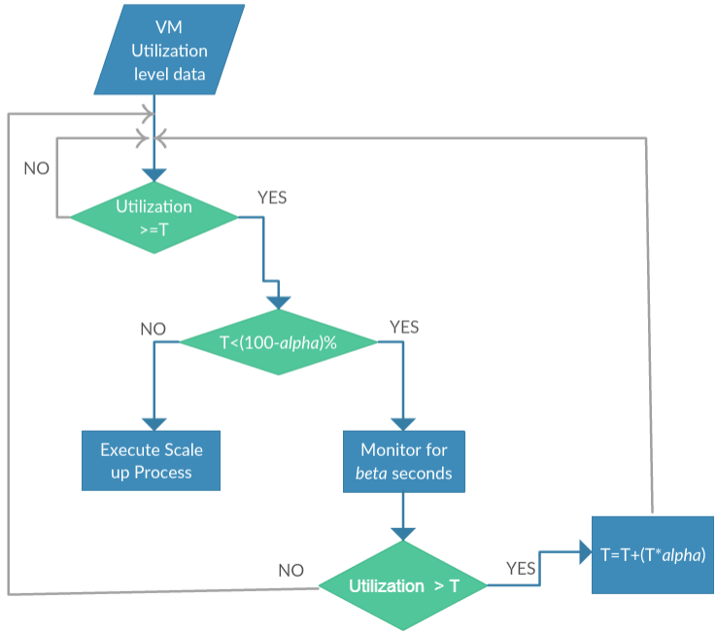
SCALING UP
Collected data is analyzed and the current utilization of the data is determined.
Test: current utilization > Threshold?
Once the test passes, check if Threshold is fully utilized.
If not, monitoring phase starts for β seconds.
By the end of the observation phase Is current utilization > threshold ?
Yes, threshold is increased by α percent.
Repeat until threshold >(100- α)% (full utilization)
Assuming α =10
Stop when T>90%

Slide 12
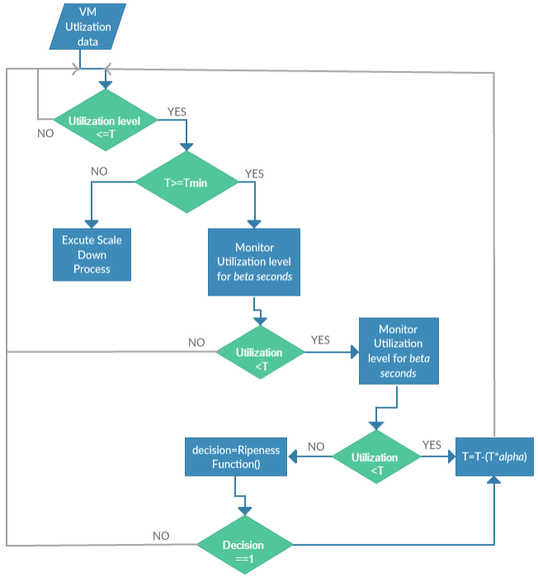
SCALING DOWN
Tmin: the lowest tolerance level the threshold can reach
Collected data is analyzed and the current utilization of the data is determined.
Test: current utilization =< Threshold?
Once the test passes, monitoring phase starts for β seconds.
By the end of the observation phase Is current utilization <Tmin scale down
If current utilization <Threshold, but current utilization > Tmin then:
Threshold is decreased by α percent temporary , a second monitoring period starts
Changes are permeant if by the end current utilization is still less than threshold

Slide 13
Strengths and Weaknesses
Strengths:
Accurate
Reduced Costs
Leveraging real time data to adapt the threshold
Avoid false positive
Weakness:
Performance depends on the selection of the initial threshold and alpha.

Slide 14
Queuing Theory based Technique

Slide 15
Main Concept
A study in mathematics
The arrival of request is viewed as arrival of customers waiting to be served.
A single queue can be serviced by one or multiple servers
The following notation is used to describe a system in queuing theory A/B/C/X/Y/Z:
A: Distribution of request arrival time
B: Distribution of service time
C: Number of parallel servers available
X: Capacity of the server
Y: Calling population
Z: service disciplines

Slide 16
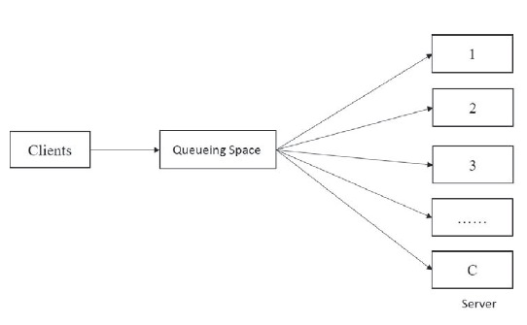
Review Paper – Brief Description (1/4)
Paper title – ‘Auto Scaling Virtual Machines for Web Applications with Queueing Theory’
Goal: to address the inconsistent usage of reserved resources
Number of access to a web application fluctuate over time.
Peak-valley phenomenon: “ The amount of reserved resources is often proportional to the peak needed of physical resources, while most of the time the required resources is far below the peak load and thus physical servers will be idle most of the time”

Slide 17
Review Paper – Brief Description (2/4)
Queuing model: M/M/C
Request arrival time (M): follows a Poisson distribution
Service time (M): follows an exponential distribution
Number of servers (C)
In practice such system is called “ a system with a multi service of a queuing model M/M/C
The system includes a Load Balancer (LB)

Slide 18

Review Paper – Brief Description (3/4)
Using the mathematics and the of queue theory and the performance metrics of the system the authors defined equations that computes:
Idle probability of the system
Average number of requests in a queue
Average number of requests handled by the system
Expected wait time in the queue
Expected wait time in the system
The Problem: given a system state how to decrease the demand of resources and the waiting time in the queue
The proposed resource allocation function: computes optimal number of resources Vt+1 in time interval t+1

Slide 19
Review Paper – Brief Description (4/4)
Scale Up Or Down?
If the optimal number of resources Vt+1 > current number of resources V then scale up otherwise scale down.
Scale Up :
A heuristic algorithm used to determine which VM needs to be scaled and how much
Ai the remaining resources in a i-th VM
B is the maximum resources a VM can support
If Ai<B then scaling up is possible.
The average of Ai is assigned to the VM, and Ai is updated to the number of the remaining resources after scaling
Scale Down
Only horizontal scaling is considered.
It’s a 0-1 knapsack problem
A dynamic programming algorithm is used to determine which VMs to terminate

Slide 20
Strengths and Weaknesses
Strengths
Makes use of queue theory simplicity
Resources are fully utilized, added when needed and removed when the load is low.
Weakness
Only suitable when the request arrival rate follows an exponential distribution.

Slide 21
Reinforcement Learning based Technique

Slide 22
Main Concept
The automation of the scaling task is not dependent on any pre-existing knowledge or any performance model of the application.
Scaling decisions are made and improved on while the application is running - using a trial and error approach.
Preliminary Concepts –
Agent - The auto scaler component in RL is known as the agent.
State - Current Application State.
Action - When a state change occurs in the application, the agent can choose to perform an action.
Reward - The action chosen for a given state is then rewarded according to the nature of the succeeding states.
“ The agent learns and assigns actions to different states in such a way so as to maximize collected rewards.’’
Notes:
Action - which could either be to scale horizontally, scale vertically, or perform no action at all. These actions are selected based on the current state of the application, its workload and the response rate.
Reward - That is, if the application is in a better situation, in terms of performance, after an action is performed, the committed action is then considered optimal for the time being and the action is positively rewarded and vice versa.
In essence, it is this rewarding system that drives the agent to select the appropriate actions for the given application states.
In order to understand how RL techniques are applied in the literature, for this review, we reviewed the implementation of RL techniques in both a single layered application and in a multi-layered web applications.

Slide 23
Architecture
Notifies
state change
Rewards
Action Performed
Reward the Action
Environment
Agent
Acts Upon

Slide 24
Review Paper – Brief Description (1/3)
Paper title – ‘Unsupervised Learning of Dynamic Resource Provisioning Policies for Cloud - hosted Multitier Web Applications.’ - Iqbal et. Al
They addressed auto scaling using RL for multi-layer web application.
Their proposed solution - complete auto scaler - both workload pattern prediction and resource provisioning policy learning.
For policy learning part - adaptive resource allocation for every tier of multi-tier web applications - online unsupervised method for policy learning.
Policies - they set their learning agent to use a simplistic method to find the policies that maximizes the objective function and thus the reward – it does so by predicting the value of each possible action.
Only does vertical scaling - scaling process is triggered when an SLA violation is encountered.
Notes:
Iqbal et. Al in their paper addressed auto scaling using RL for multi-layer web application.
Their proposed solution is a complete auto scaler that has both workload pattern prediction and resource provisioning policy learning.
For policy learning part, their implementation performs adaptive resource allocation for every tier of multi-tier Web applications using an online unsupervised method for policy learning.
They set their learning agent to use a simplistic method to find the policies that maximize an objective function which rewards satisfying a response time adherence, SLA contracts with minimal resources utilization as possible. They defined the system state at time t as
Their auto scaler was designed to only do vertical scaling but on different tiers. So according to need, the agent could scale up the Web tier ($a_w$), scale up the database tier ($a_d$), scale up both tiers ($a_b$), or do no scaling ($a_\phi$).
As in most reinforcement learning techniques, they consider the policy to be a value function that maximizes the reward. This function does so by predicting the value of each possible action and selecting the one with the highest predicted reward.

Slide 25
Review Paper - Brief Description (2/3)
Implemented their approach in 2 algorithms for different phases - Exploration phase, which is the online learning phase - Exploitation phase which is the decision-making phase.
Exploration phase : -
Starting with no knowledge, the learning agent periodically monitors for SLA violations – once agent detects any violation - it selects the action with the highest reward.
Exploring of all the possible actions is done using a simple exhaustive exploration algorithm.
Each of the states visited during this phase are logged and later used to build a neural network regression model.
For given workload and tier configuration, this model will then be used to predict the service time required for by the auto scaler during next phase.
Notes:
With respect to the algorithms, they implemented their approach in 2 algorithms, one for the exploration phase, which is the online learning phase and other for the exploitation phase which is the decision-making phase.
The resources scaling process is triggered when an SLA violation is encountered.
For the exploration phase, starting with no knowledge, the learning agent periodically monitors for SLA violations. If the agent detects any violation, it selects the action with the highest reward by attempting all possible actions.
The process of exploring of all these actions is done using a simple exhaustive exploration algorithm. Each of the states visited during this phase are logged and later used to build a neural network regression model.
This model will then be used to predict the service time required for by the auto scaler during the exploitation phase for a given workload and tier configuration.
During the exploitation phase, when an SLA violation is perceived, the value of each action is calculated by first predicting the service time that the action would take by using the regression model and then by calculating the reward.
Once that is complete, the action with the maximum reward is selected. They maintain a pool of already booted VMs to quickly add to a specific tier of application when the need arises.

Slide 26
Review Paper - Brief Description (3/3)
Exploitation Phase :-
When SLA violation is perceived - the value of each action is calculated by – first by using the regression model and predicting the service time that the action would take and then by calculating the reward.
Once that is complete, the action with the maximum reward is selected.
Notes:
With respect to the algorithms, they implemented their approach in 2 algorithms, one for the exploration phase, which is the online learning phase and other for the exploitation phase which is the decision-making phase.
The resources scaling process is triggered when an SLA violation is encountered.
For the exploration phase, starting with no knowledge, the learning agent periodically monitors for SLA violations. If the agent detects any violation, it selects the action with the highest reward by attempting all possible actions.
The process of exploring of all these actions is done using a simple exhaustive exploration algorithm. Each of the states visited during this phase are logged and later used to build a neural network regression model.
This model will then be used to predict the service time required for by the auto scaler during the exploitation phase for a given workload and tier configuration.
During the exploitation phase, when an SLA violation is perceived, the value of each action is calculated by first predicting the service time that the action would take by using the regression model and then by calculating the reward.
Once that is complete, the action with the maximum reward is selected. They maintain a pool of already booted VMs to quickly add to a specific tier of application when the need arises.

Slide 27
Review Paper – Evaluation Techniques Used
In order to evaluate their work, they implemented their policy learning module on a two-tier web application installed on Amazon Elastic Compute Cloud (EC2) and RUBiS, a benchmark Web application for auctions, as a sample web application.
Two experiments – light workload pattern and heavy workload pattern.
Analysed and compared the performance of their policy learning methods with the industry standard rule based methods CPU reactive and response reactive.
The performance metrics they looked at were the total number of allocated CPU hours and the percentage of requests violating the SLA.
Their proposed solutions allocated fewer CPU hours in the policy learning stage for both experiments.
However, in terms of requests violating the SLA, they had a higher percentage for exploration and exploitation phases compared to CPU reactive and response reactive.
Notes:
In order to evaluate their work, they implemented their policy learning module on a two-tier web application installed on Amazon Elastic Compute Cloud (EC2) and RUBiS, a benchmark Web application for auctions, as a sample web application.
They tested their models on two experiments – light workload pattern and heavy workload pattern. For the former case, they modelled each user session to have 32 user requests and assigning lesser resources than required to complete their tasks. In the case of the heavy workload experiment, they modelled each user session to have 10 user requests that require intensive resources which require a long time to process.
They analysed and compared the performance of their policy learning methods – exploration and exploitation with the industry standard rule based methods CPU reactive and response reactive.
The performance metrics they looked at were the total number of allocated CPU hours and the percentage of requests violating the SLA.
Their proposed solutions allocated fewer CPU hours in the policy learning stage for both experiments.
However, in terms of requests violating the SLA, they had a higher percentage for exploration and exploitation phases compared to CPU reactive and response reactive.
Their argument was that, since the workload is always increasing in both experiments, the other methods fall into the mistake of overprovisioning of resources so as to avoid increasing the number of requests that violate the SLA.

Slide 28
Review Paper – Strengths and Weaknesses
Strengths
Their proposed method is it considers both the raw arrival rate and the workload pattern - the learner is better at provisioning resources.
Scaling strategy - prioritize scaling out at the web tier over database tier for actions with same response time. – Avoid data synchronization in the database tier and overhead load balancing at the web tier caused by database tier.
Weakness
Assumption that their system would always have sufficient bandwidth and enough time would be given to the auto-scaler to collect access logs from the application, learn and implement a policy before workload changes occur.
Notes:
One of the strengths of their proposed methods is that since the input function considers both the raw arrival rate and the workload pattern, the value-function can have different values for the same state-action pair depending on the arrival rate of requests and how intensive the workload pattern is. It is because of this flexibility, that the learner is better at provisioning resources. The basic guideline of the reward function is to encourage the learning agent when it respects the SLO while utilizing the minimum number of resources and vice versa.
Another strength in this paper is their scaling strategy in terms of what tier in a multi-tier application is scaled. Interestingly, they prioritize scaling out at the web tier over database tier when both actions result in achieving the same response time. They argue that scaling the database tier introduces overhead of load balancing at the web tier and data synchronization in the database tier which can be avoided by scaling at the web tier.
Weakness
While this paper offers compelling arguments, it also has weaknesses. One clear weaknesses is that they proposed their solution with an assumption that their system would always have sufficient bandwidth and that enough time would be given to the auto-scaler to collect access logs from the application, in order to learn and implement a policy before workload changes occur.

Slide 29
Time Series Analysis based Technique

Slide 30
Main Concept
Auto-scaling problem can be divided into two main steps:
Prediction
Decision-making
Time series analysis can only be applied to the first step (i.e. prediction step).
Time Series prediction:
Analyzing the historical data
Historical data are performance metrics
Historical data (i.e. q observation ) periodically sampled at fixed time intervals at a predefined window size w.
Last q observations are used for prediction.

Slide 31
Review Paper – Brief Description
Paper title – ‘Hybridscaler: Handling bursting workload for multitier web applications in cloud’
This work proposed a hybridScaler algorithm for resource allocation which combines between horizontal and vertical scaling.
They propose an algorithm that gives the scaling-decision without specifying the number of resources to allocate.
Vertical scaling
Horizontal scaling
Notes:
Authors argues that other consider the metrics in isolation

Slide 32
Review Paper – Approach Overview
Why Combine both scaling techniques, horizontal and vertical?
Reactive horizontal scaling
VMs booting time overhead – ranges between 5 to 10 minutes
Proactive horizontal scaling
Short-term bursting workload cause extra cost and significant overhead.
Reactive vertical scaling
A lightweight approach which adds/remove VCPUs and RAMs instantly.
Notes:
Authors argues that other consider the metrics in isolation

Slide 33
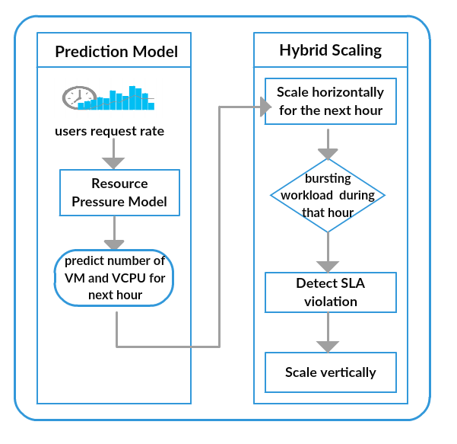
Review Paper – Approach Architecture
Performance metrics used:
Users request rate
Resource Pressure Model predicts:
Number of VMs
Number of VCPUs
First action → to scale horizontally for the next hour.
SLA violation detection → scale vertically
Notes:
Authors argues that other consider the metrics in isolation

Slide 34
Strengths and Weaknesses
Strengths:
The algorithm is able to handle the spike (i.e. burst workload)
Minimize SLA violation
Not only scaling decision, but it predict number of resources to allocate.
Weakness:
Assume that all VMs are homogeneous.
Notes:
Authors argues that other consider the metrics in isolation

Slide 35
Evaluation of Techniques

Slide 36
Reactive based techniques
Threshold-based and queuing theory techniques have a problem of having overhead delays in the auto scaling process. - allocated resources need to be setup at the time of need.
No longer the trend- used in collaboration with other techniques to overcome their weaknesses
Queuing theory - comparatively more favourable due of its simplicity- still not applicable for all systems. - bound by requests arrival rate in the system.
Notes:
In this section, we discuss the strengths and weaknesses of the different techniques discussed above. We also discuss where each of these techniques could effectively be used.
For example, when more virtual machines are required, booting them usually takes anywhere from 5 to 10 minutes thus resulting in a noticeably slow reaction to workload changes
As explained earlier, it adopts a learning process and auto scales accordingly. This is useful for applications that have unpredictable workload patterns.

Slide 37
Proactive based techniques
Introduced to solve the problem of overhead delay seen in reactive based techniques - by predicting the need for the resources before hand - especially useful for the dynamic demands of web applications.
Weakness of proactive techniques – don’t perform well for very unpredictable types of workload such as those brought by short-term burst workload.
Strength of RL - ability to easily be plugged and used in any application on the go - useful for applications that have unpredictable workload patterns.
Strength of TSA - For applications that have predictable workload patterns and stored application logs and usage details - uses historical data as prior knowledge to train the prediction model
Weakness of RL - learning process in most cases a time-consuming process - caused due to the time it takes for the learning process to learn the most appropriate action for each state. - may become impractically long in some cases.
Notes:
In this section, we discuss the strengths and weaknesses of the different techniques discussed above. We also discuss where each of these techniques could effectively be used.
For example, when more virtual machines are required, booting them usually takes anywhere from 5 to 10 minutes thus resulting in a noticeably slow reaction to workload changes
As explained earlier, it adopts a learning process and auto scales accordingly. This is useful for applications that have unpredictable workload patterns.

Slide 38
Conclusion

Slide 39
Strengths and Weaknesses
For our review,
Discussed various techniques used in the literature to solve the scalability problem in cloud computing.
Discussed the strengths and weaknesses of the different techniques.
Shed some light on where each of the techniques would likely be better suited to be used.
Noticed that recent works are now focusing more on the predictive techniques rather than the reactive techniques. - proactive methods facilitate a more faster solution to the scalability process.
Currently - lot of research being done to try to improve proactive approaches so as to handle this sudden change type of workloads.
Notes:
by predicting the load beforehand and reacting accordingly by providing the needed resources. By doing so, the proactive based auto-scalers are better at avoiding overprovisioning or underprovisioning of resources.

Slide 40
Thank You!

